Slide 1








WSP Project
C29-tw-wsp-grp3
Joz Chow and Marco Wong
Presentation

Slide 2
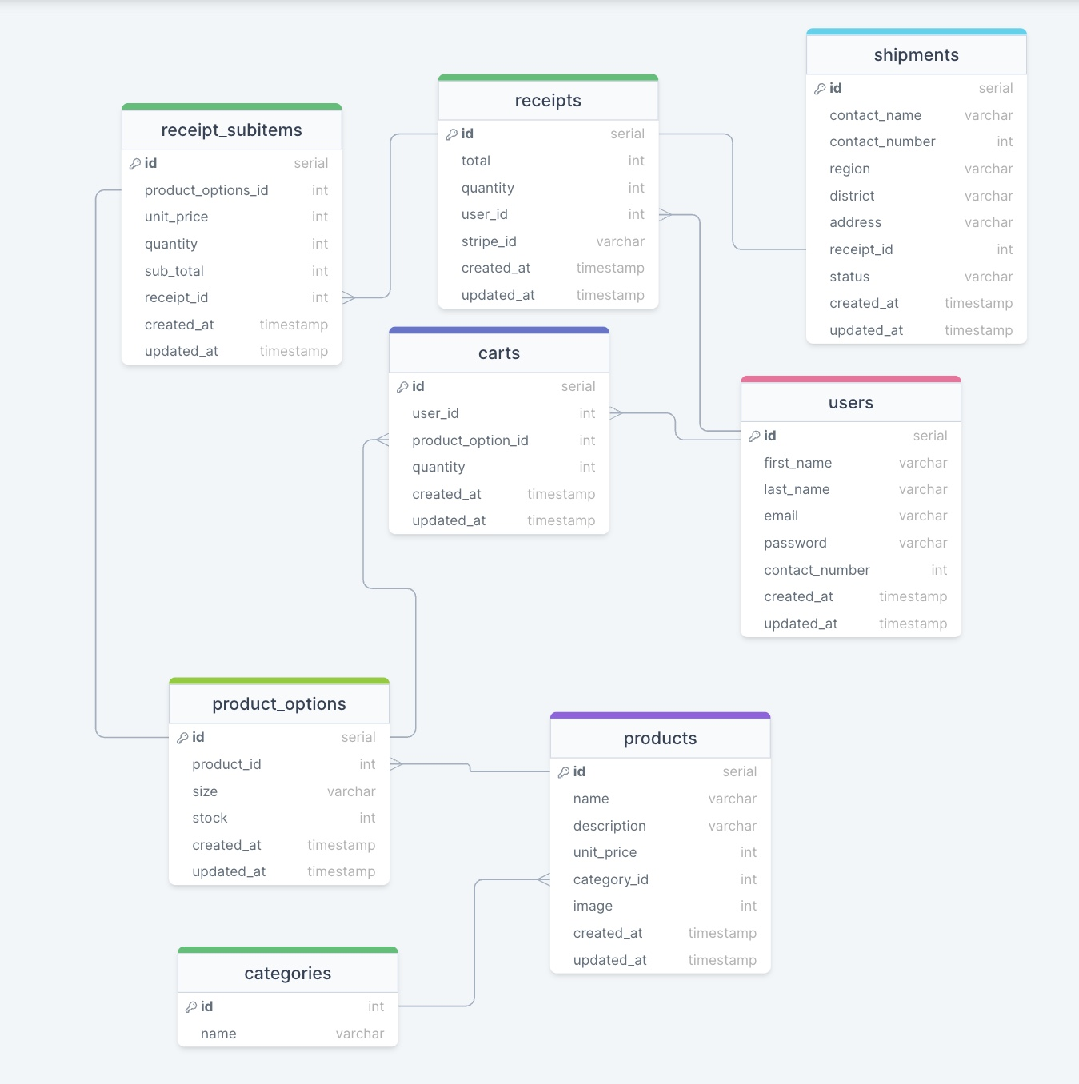

Slide 3





Link Here:
http://localhost:8080

